Slide 1
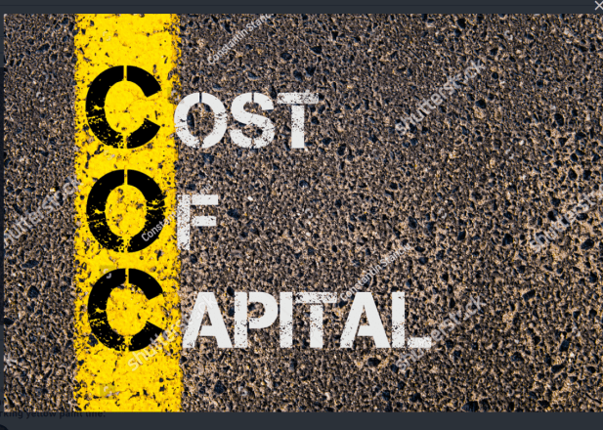

Slide 2
Measurement of Cost of Capital
The measurement of cost of capital refers to the process of determining the cost of funds to the firms. Once, the cost has been determined, it is in the light of this cost that the capital budgeting proposal will be evaluated.
If there is a mistake in the determination of the cost of capital, then the investment decision as well as other decisions may be taken wrongly and thus, ultimately affecting the profitability and survival of the firm.

Slide 4
Classification of Cost of Capital
Explicit Cost-The explicit cost of any source of capital may be defined as the discount rate equals to the present value of the cash inflows that are incremental to the taking of financing opportunity with the present value of its incremental cash outflow. In other words, explicit cost or direct cost refers to the interest rate adjusted for tax savings and the cost of raising funds.
Implicit Cost -It is the rate of return associated with the best investment opportunity for the firm and its shareholders that will be foregone of the project presently under consideration by the firm was accepted.
Marginal Cost -It is the additional cost incurred to obtain additional funds required by a firm. It refers to the change in the total cost of capital resulting from the use of additional funds.

Slide 5
Average Cost/Composite/Overall Cost -Average cost of capital is the weighted average cost of capital calculated on the basis of costs of the different components of equity, preference shares, debentures and retained earnings.
Historic Cost/ Book Cost -Historical cost refers to the cost, which has already been incurred for financing a project.
Future Cost -It refers to the expected cost of funds to be raised for financing a project. For all decision-making purposes, future cost is the relevant one than in comparison with the historic cost.
Spot Cost -The cost that are prevailing in the market at a certain time.

Slide 6
THANK YOU

